Slide 1
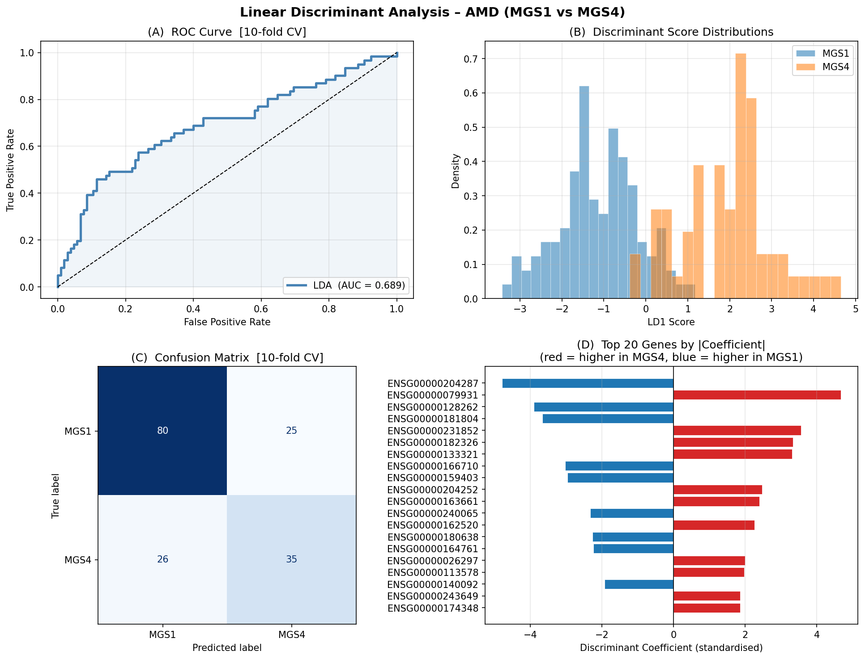
Linear Discriminant Analysis (LDA)
Can a straight-line boundary separate MGS1 from MGS4?
Key Results
AUC = 0.689
Model is better than random chance (>0.5) but leaves room for improvement
Correctly identified:
• 80 / 105 MGS1 samples (76%)
• 35 / 61 MGS4 samples (57%)
Missed nearly half of advanced AMD cases
Top discriminant genes:
• HLA-DRA — higher in MGS1
• MOXD1 — higher in MGS4
• C1R, C1S, SLC9A9 present in top 20
Limitation: assumes a linear boundary in 81-dimensional gene space — likely too simple
AMD RNA-seq Analysis | Advisor Update

Slide 2
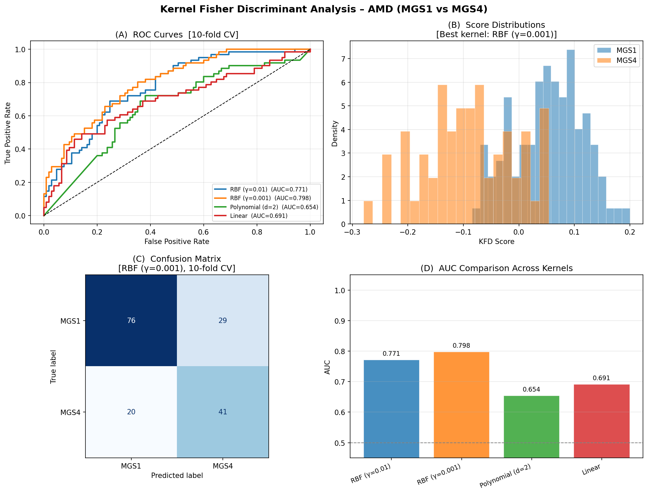
Kernel Fisher Discriminant Analysis (KFDA)
Allowing a curved decision boundary — does it help?
Key Results
Best kernel: RBF (γ=0.001)
AUC = 0.798 (+16% vs LDA)
Correctly identified:
• 76 / 105 MGS1 (72%)
• 41 / 61 MGS4 (67%)
MGS4 sensitivity improved from 57% → 67% vs LDA
Four kernels tested:
• RBF γ=0.001 0.798 ✓ best
• RBF γ=0.01 0.771
• Linear 0.691
• Polynomial 0.654
RBF kernel captures non-linear gene interaction patterns that LDA cannot detect
AMD RNA-seq Analysis | Advisor Update

Slide 3
LDA vs KFDA — What the Difference Tells Us
The improvement reveals something important about AMD biology
LDA
KFDA (RBF)
AUC
0.689
0.798
MGS4 sensitivity
57%
67%
Decision boundary
Linear
Curved (RBF kernel)
Best for
Speed / interpretability
Accuracy / non-linear patterns
Biological implication
The 16% AUC gain from LDA → KFDA means the boundary between early and advanced AMD in gene expression space is curved, not straight. Gene effects are not simply additive — they interact. This is consistent with the network rewiring seen in the bHUB analysis: it is not one gene changing, it is an entire co-expression module reorganising.
AMD RNA-seq Analysis | Advisor Update

Slide 4
Bayesian Hub Analysis (bHUB)
Identifying which genes act as central connectors in each disease stage
What is a hub gene?
In a co-expression network, genes are nodes and edges represent correlated expression. A hub gene connects to many others — it coordinates the activity of a large group of genes. If a hub is disrupted, it affects the entire module it controls.
What does bHUB do?
Builds a separate co-expression network for MGS1 and MGS4
Identifies hub genes in each network with a probability score
Links the two networks via a sharing parameter τ
Uses all 105 MGS1 and 61 MGS4 samples
PPI = posterior probability of being a hub (0 to 1)
Genes that are hubs in both groups = co-hubs
Hub classification rule
A gene is declared a hub if its posterior probability (PPI) ≥ 0.5. This means the data provides stronger evidence for hub status than against it.
AMD RNA-seq Analysis | Advisor Update

Slide 5
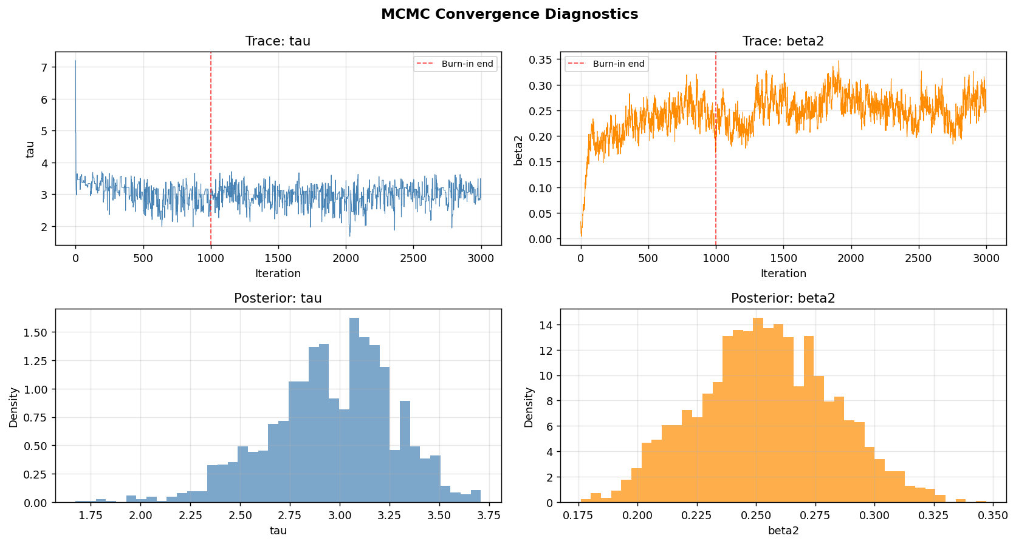
bHUB: MCMC Convergence — The Algorithm Worked Correctly
Before trusting the results, we verify the sampler behaved well
What to look for
Traces (top panels):
Flat and noisy after the red dashed line = good. No drift = converged.
τ ≈ 3.0 (posterior mean)
Strong evidence for hub sharing between MGS1 and MGS4
β₂ ≈ 0.25
Hub-connected edges are 250× more likely to be real than non-hub edges
(β₁ = 0.001)
Bottom panels show smooth posterior distributions — well-behaved estimates
Conclusion: results are statistically reliable
AMD RNA-seq Analysis | Advisor Update

Slide 6
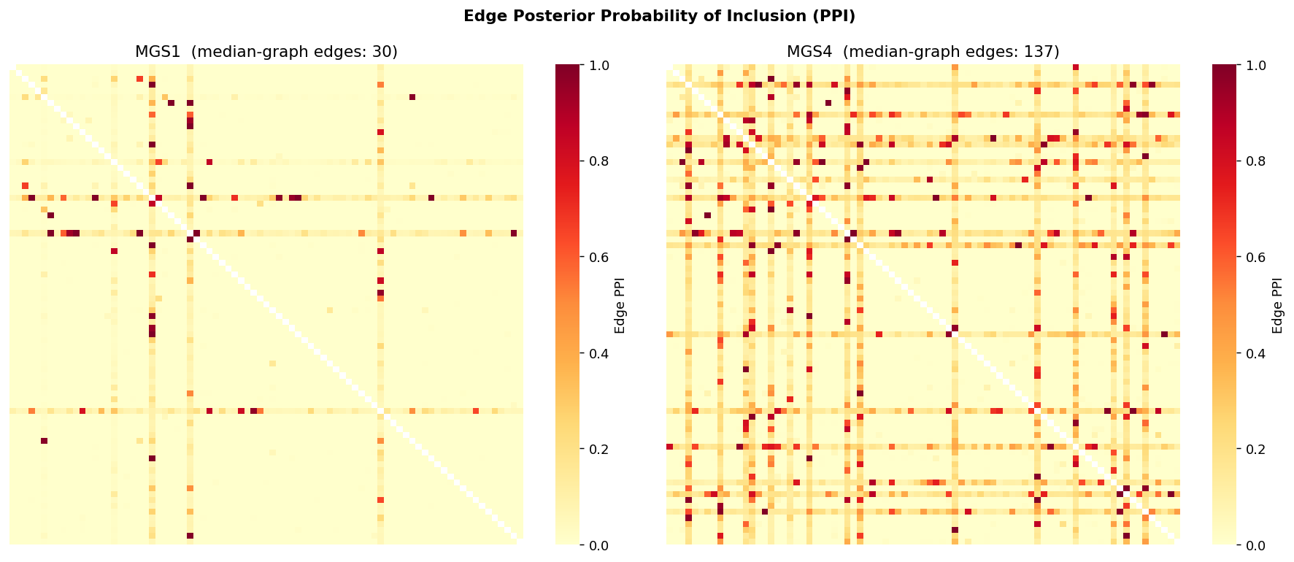
bHUB: Network Structure Changes Dramatically with Disease Stage
Edge PPI heatmap — each cell is the probability that two genes are connected
How to read this
Dark red cell = two genes are almost certainly co-expressed together
Yellow = no meaningful connection
A hub gene appears as a bright stripe (row + column)
MGS1: 30 edges
Sparse — few connections
MGS4: 137 edges
Dense — 4.6× more connections
The network does not just grow — it reorganises around new hub genes
AMD RNA-seq Analysis | Advisor Update

Slide 7
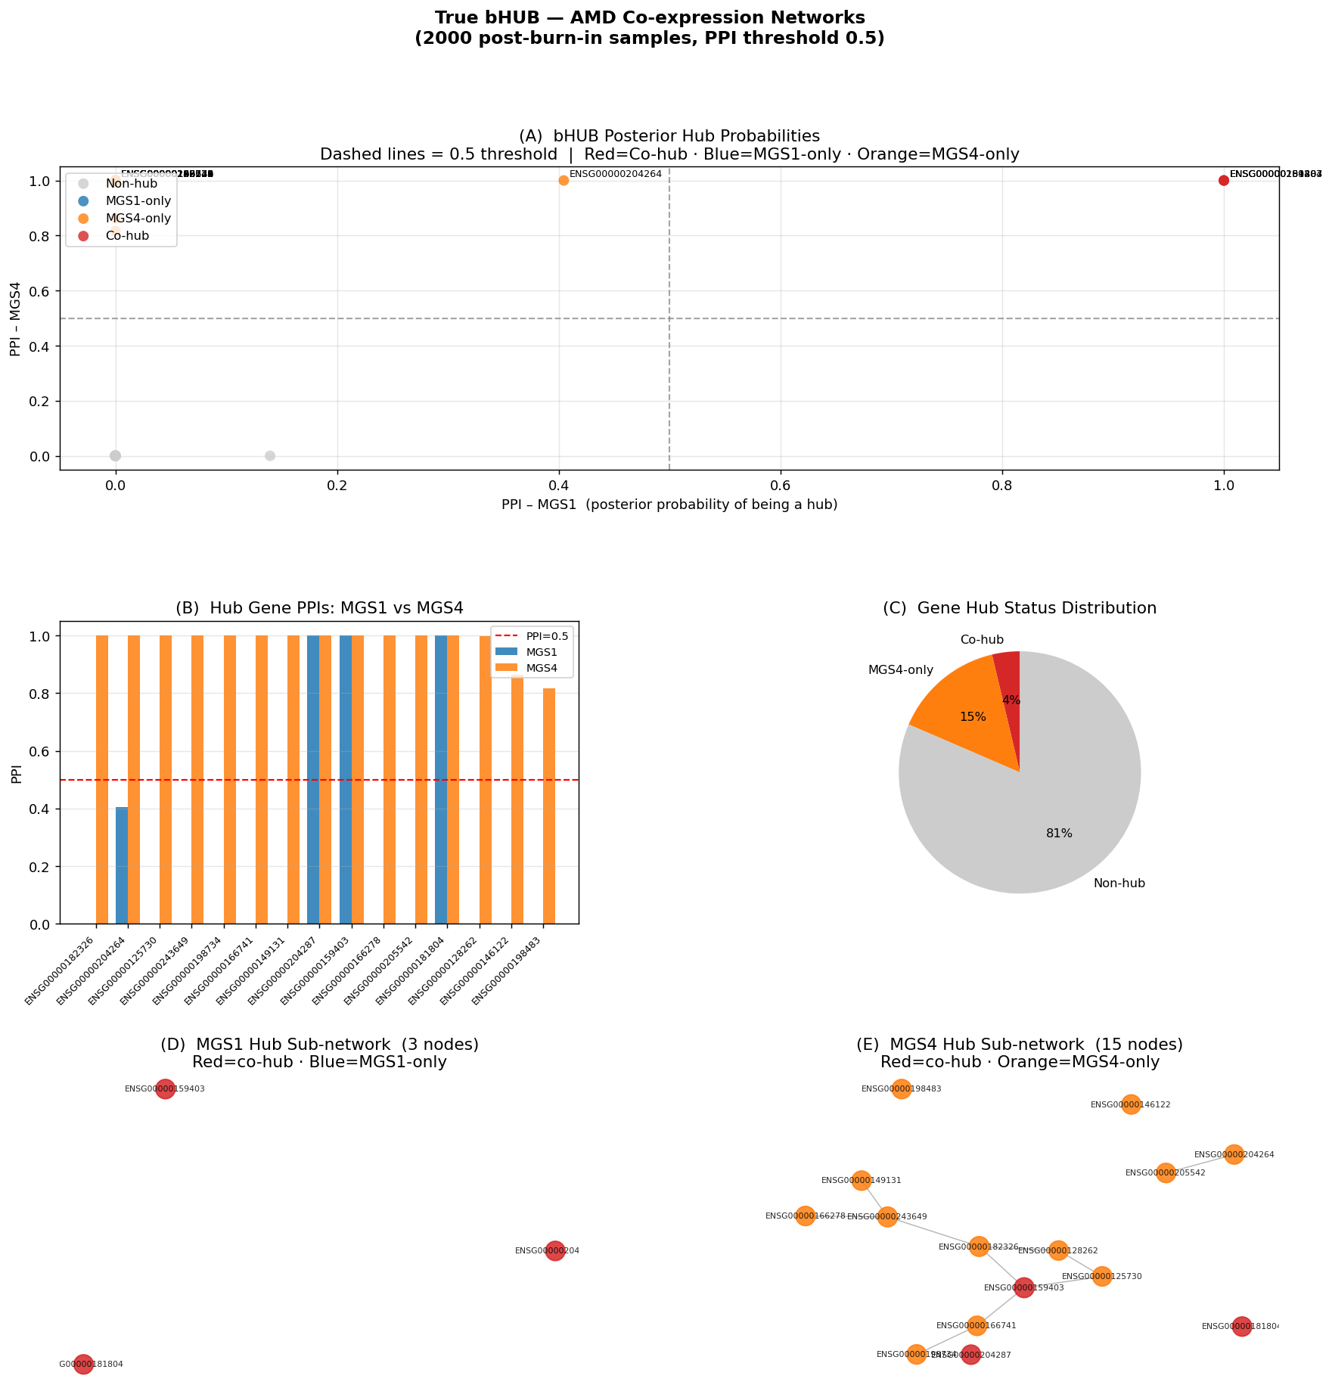
bHUB: Hub Gene Results
Which genes are the central connectors in each stage?
Summary
[Image not found: bhub_true_results.png]
Co-hubs (hub in BOTH stages) PPI = 1.0
HLA-DRA MHC class II immune receptor
C1R Complement C1r protease
SLC9A9 Na⁺/H⁺ exchanger (endosomal pH)
MGS4-only hubs (appear only in advanced AMD)
C1S, C2, C3, CFB — complement cascade
SERPING1 — complement inhibitor
PSMB8 — immunoproteasome
TMSB4X — tissue repair
NNMT — metabolic reprogramming
F5 — coagulation factor
0 MGS1-only hubs
No gene is a hub exclusively in normal/early tissue
81% of genes: Non-hub in both stages
AMD RNA-seq Analysis | Advisor Update

Slide 8
Biological Interpretation
What do all three analyses tell us about AMD progression?
Both Stages (Co-hubs)
These three genes are the stable regulatory core of the AMD network. HLA-DRA (immune antigen presentation) and C1R (complement C1r) are consistently central regardless of disease stage, suggesting immune priming exists even before advanced AMD develops. SLC9A9 points to chronic endosomal pH dysregulation in the retinal pigment epithelium.
HLA-DRA · C1R · SLC9A9
Advanced AMD Only (MGS4 hubs)
The entire complement cascade becomes co-hub in MGS4. This is not one gene malfunctioning — it is the full pathway wiring up as a coordinated module. SERPING1 (C1-inhibitor) also becomes a hub, likely as a failed feedback response to out-of-control complement activation.
C1S · C2 · C3 · CFB · SERPING1
Disease Transition (Network rewiring)
The network more than quadruples in connectivity from MGS1 to MGS4. KFDA capturing this non-linearity (AUC gain vs LDA) is consistent: AMD progression is a system-level reorganisation, not a simple shift in a few gene expression levels.
30 → 137 edges (+357%)
AMD RNA-seq Analysis | Advisor Update

Slide 9
Cross-Method Convergence — Strongest Evidence
Genes that appear important across ALL three independent analyses
When a gene is flagged by LDA coefficients, separates classes in KFDA, AND is identified as a hub in bHUB — that is strong, multi-method evidence. These are the highest-priority candidates for follow-up.
Gene
LDA Coefficient
KFDA Contribution
bHUB Status
Biological Role
HLA-DRA
−4.79 (top gene)
Strong separator
Co-hub PPI=1.0
MHC class II; immune antigen presentation
C1R
−2.96 (top 10)
Clear contributor
Co-hub PPI=1.0
Complement C1r; classical pathway
SLC9A9
−3.66 (top 5)
Contributor
Co-hub PPI=1.0
Na⁺/H⁺ exchanger; endosomal pH
C1S
Top 10
Contributor
MGS4-hub PPI=1.0
Complement C1s; activates C1r
C3
Present
Contributor
MGS4-hub PPI=1.0
Central complement effector
SERPING1
−1.11 (top 20)
Present
MGS4-hub PPI=1.0
C1 inhibitor; complement regulator
AMD RNA-seq Analysis | Advisor Update

